Slide 1
Microsoft Teams Shortcuts
Dan Rey
M365 Apps & Services MVP (Most Valuable Professional)
https://go.microsoft.com/fwlink/?linkid=871766
Office Accessibility Center
https://go.microsoft.com/fwlink/?linkid=846420
See Shortcuts for all platforms
@Stilldrey on Twitter
http://www.linkedin.com/in/stilldey
http://github.com/stilldrey/MS-700 Microsoft Teams Tips and Tricks

Slide 2
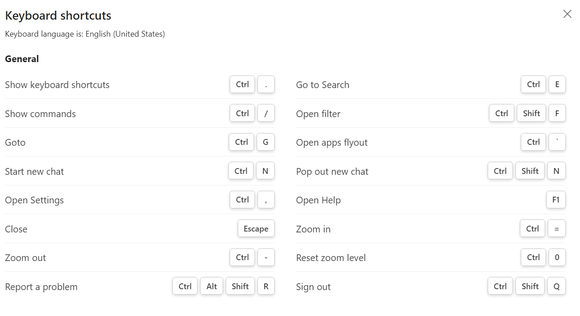
https://go.microsoft.com/fwlink/?linkid=871766
Office Accessibility Center
https://go.microsoft.com/fwlink/?linkid=846420
See Shortcuts for all platforms
@Stilldrey on Twitter
http://www.linkedin.com/in/stilldey
http://github.com/stilldrey/MS-700 Microsoft Teams Tips and Tricks

Slide 3
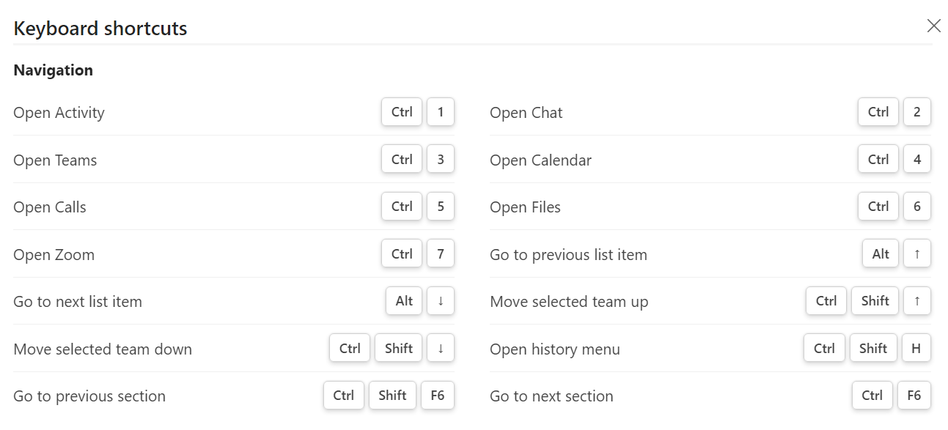
https://go.microsoft.com/fwlink/?linkid=871766
Office Accessibility Center
https://go.microsoft.com/fwlink/?linkid=846420
See Shortcuts for all platforms
@Stilldrey on Twitter
http://www.linkedin.com/in/stilldey
http://github.com/stilldrey/MS-700 Microsoft Teams Tips and Tricks

Slide 4
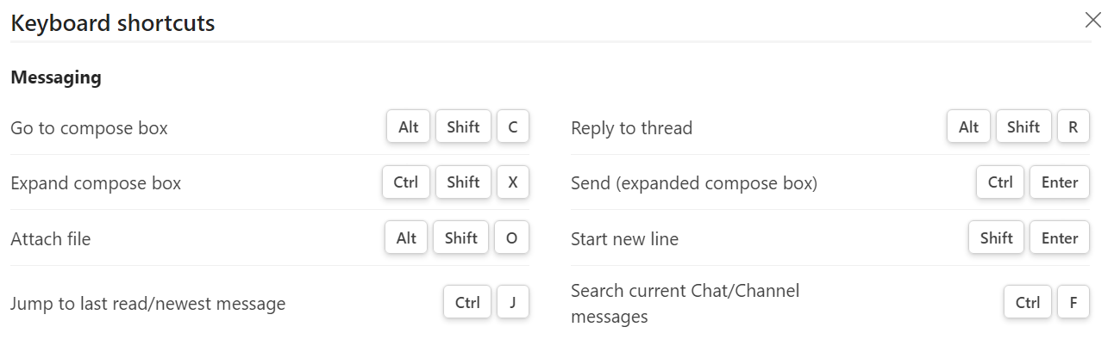
@Stilldrey on Twitter
http://www.linkedin.com/in/stilldey
http://github.com/stilldrey/MS-700 Microsoft Teams Tips and Tricks
https://go.microsoft.com/fwlink/?linkid=871766
Office Accessibility Center
https://go.microsoft.com/fwlink/?linkid=846420
See Shortcuts for all platforms

Slide 5
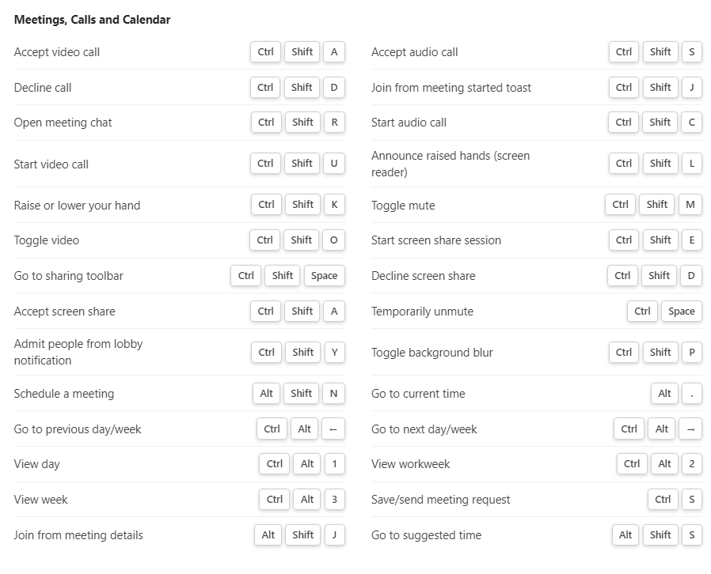
@Stilldrey on Twitter
http://www.linkedin.com/in/stilldey
http://github.com/stilldrey/MS-700 Microsoft Teams Tips and Tricks
https://go.microsoft.com/fwlink/?linkid=871766
Office Accessibility Center
https://go.microsoft.com/fwlink/?linkid=846420
See Shortcuts for all platforms

